Slide 1
Analysis of Speaker Adaptation Algorithms for HMM-Based Speech Synthesis and a Constrained SMAPLR Adaptation Algorithm
Source: TRANSACTIONS ON AUDIO, SPEECH, AND LANGUAGE PROCESSING, JANUARY 2009
Author : Junichi Yamagishi, Takao Kobayashi
Professor : 陳嘉平
Reporter : 楊治鏞

Slide 2
INTRODUCTION
For the past ten years, our group has therefore been developing speaker-independent HMM-based speech synthesis in which “average voice models” are created from several speakers’ speech data and are adapted with a small amount of speech data from a target speaker

Slide 3
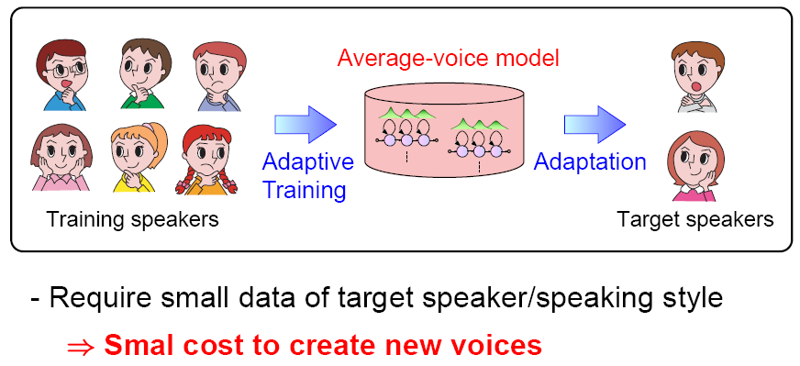
Speaker Adaptation

Slide 4
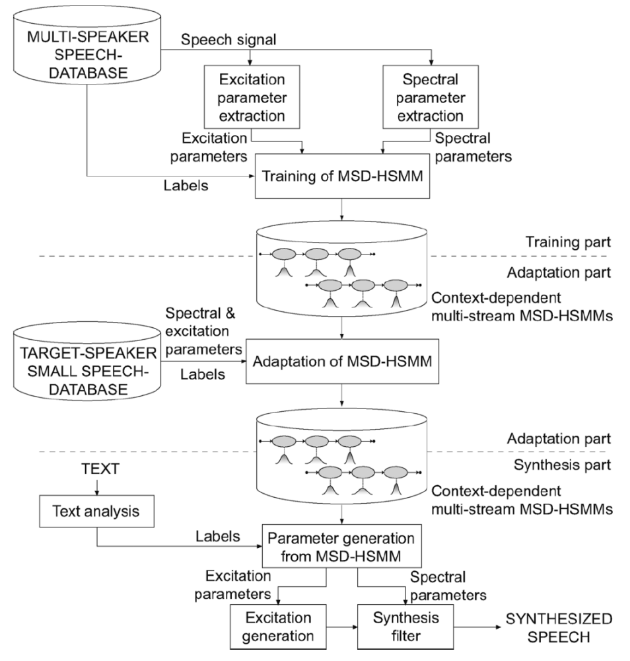

Slide 5
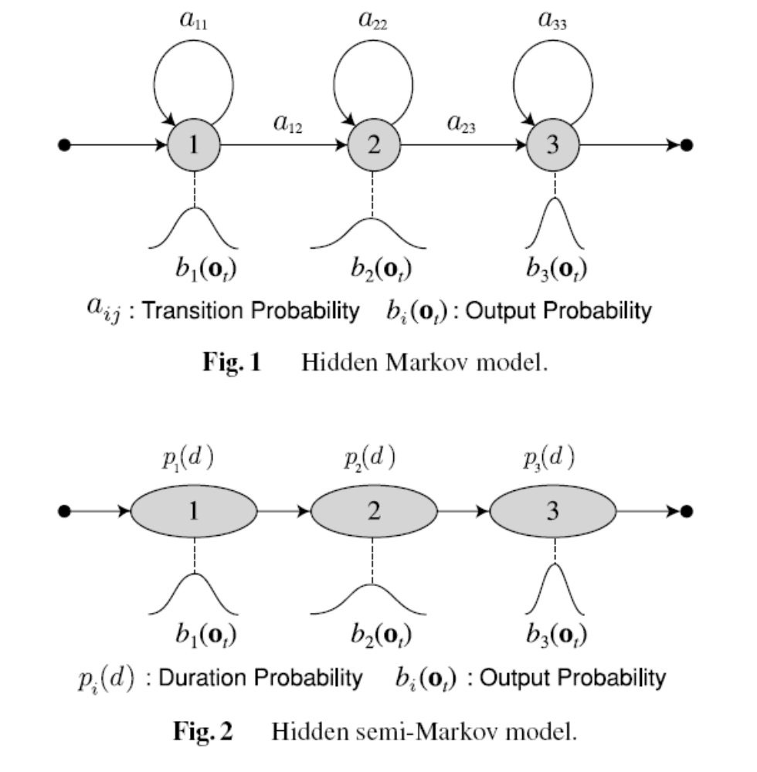

Slide 6
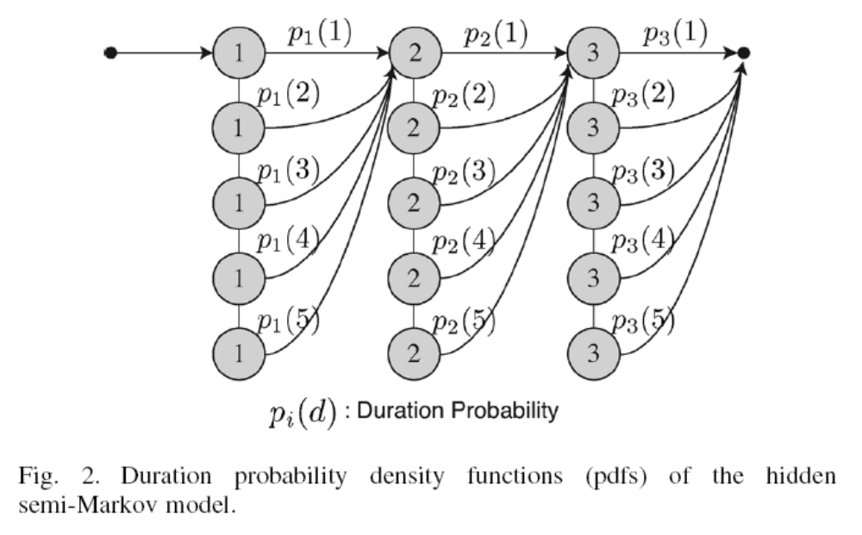

Slide 7
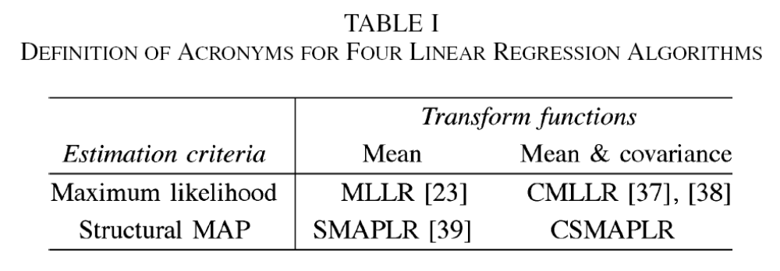

Slide 8
Constrained Maximum-Likelihood Linear Regression
In the adaptation for speech synthesis, weshould adapt both the mean vectors and covariance matrices of the output and duration pdfs to a new speaker.
In the HMM-based CMLLR adaptation, mean vectors and covariance matrices of the state output pdfs are transformed simultaneously using the same matrix.

Slide 9
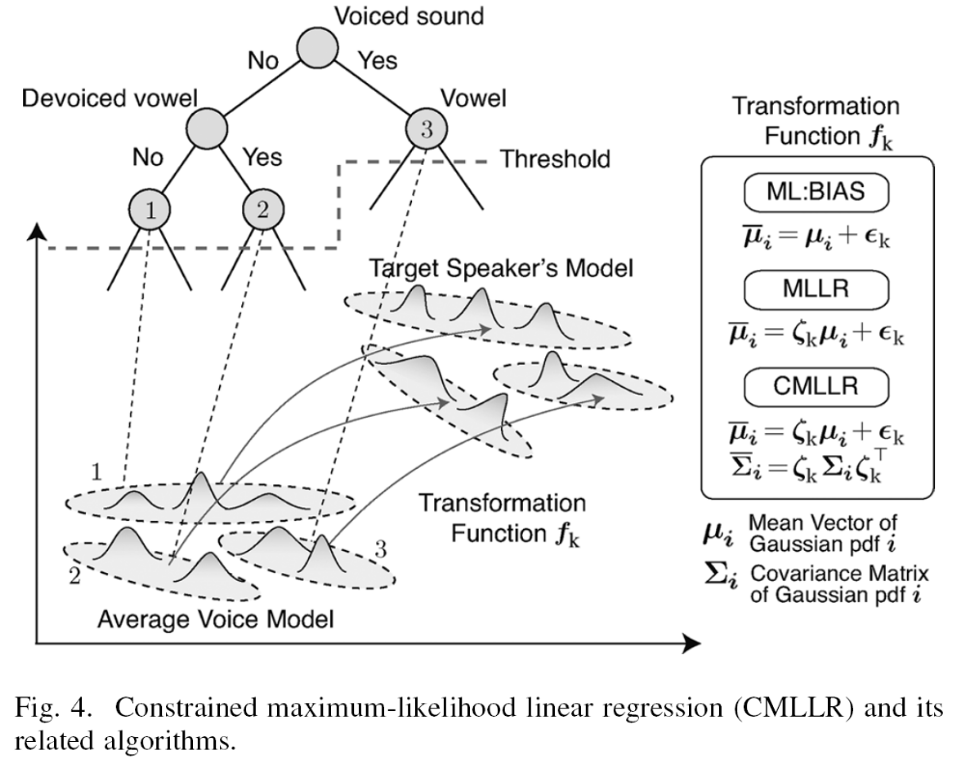

Slide 10
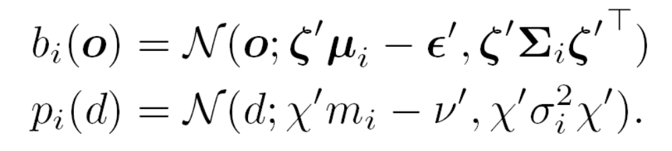
Similarly, the HSMM-based CMLLR adaptation simultaneously transforms mean vectors and covariance matrices of the state output and duration pdfs using the same linear matrices as follows:

Slide 11
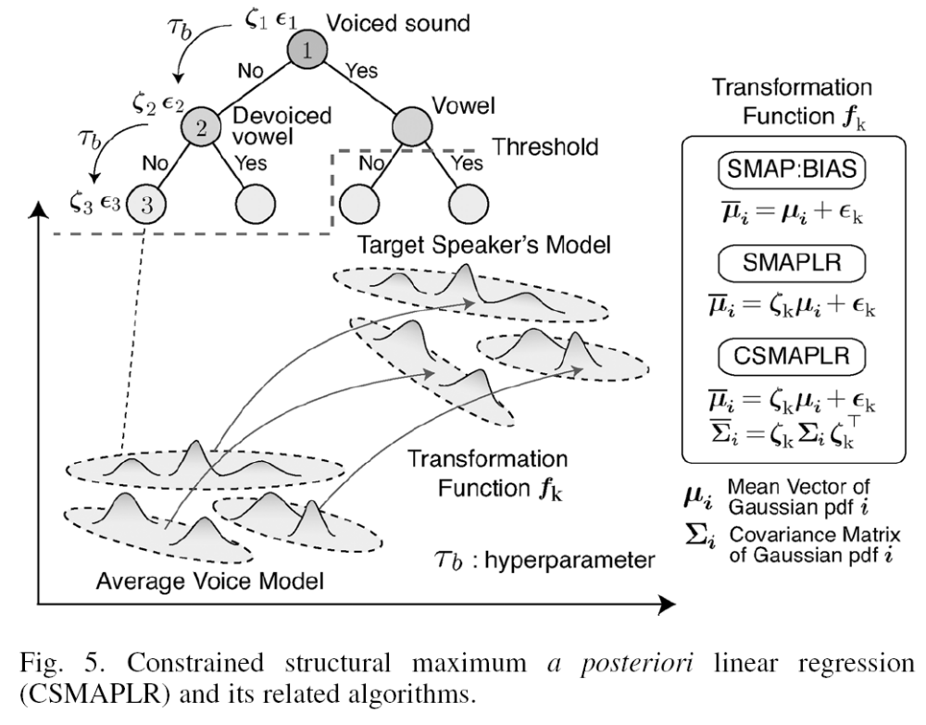

Slide 12
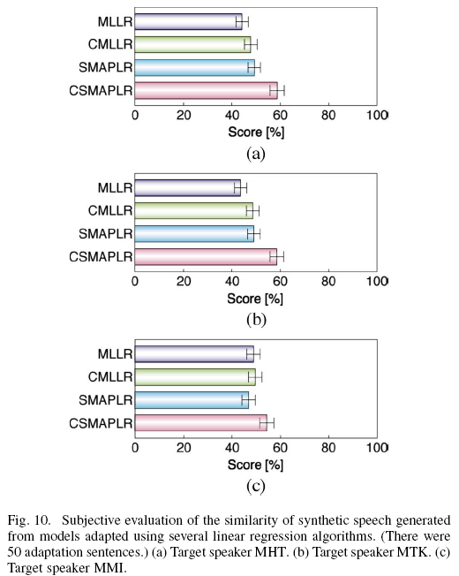

Slide 13
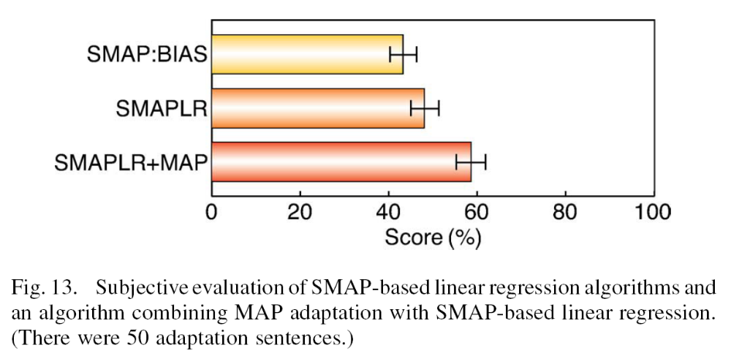

Slide 14
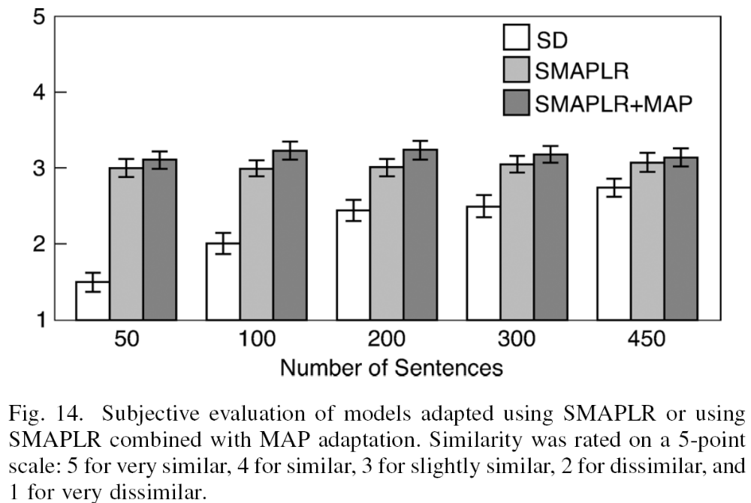

Slide 15
